Slide 1
Being Ethical and Socially Responsible

Slide 2
Learning Objectives
Understand what is meant by business ethics.
Identify the types of ethical concerns that arise in the business world.
Discuss the factors that affect the level of ethical behavior in organizations.
Explain how ethical decision making can be encouraged.
Describe how our current views on the social responsibility of business have evolved.
Explain the two views on the social responsibility of business and understand the arguments for and against increased social responsibility.

Slide 3
Learning Objectives (cont’d)
Discuss the factors that led to the consumer movement and list some of its results.
Analyze how present employment practices are being used to counteract past abuses.
Describe the major types of pollution, their causes, and their cures.
Identify the steps a business must take to implement a program of social responsibility.

Slide 4

Business Ethics
Business Ethics is the application of moral standards to business situations.
What is more important – a business’s responsibility to society, its employees, or to its stockholders?
Who determines to what moral standard businesses should be held?
© DUNDANIM/SHUTTERSTOCK
Notes:
Additional Resources
PBS Video about Business Ethics in the 21st Century
http://watch.wliw.org/program/business-ethics-21st-century/
In a new 30-minute documentary, William F. Baker leads a timely discussion about the future of American corporations and how they are redefining their approach to achieving success.
27:04
11/1/09

Slide 5

Employee Privacy
Employers monitor:
Phone calls
E-mail
Internet usage
Computer activities
Movements in the
building
© ROMAN GORIELOV/SHUTTERSTOCK
Do employees have a right to privacy, or does their time belong completely to their employers?
Notes:
5

Slide 6
Ethical Issues
Fairness and honesty
  Businesspeople are expected to refrain from knowingly deceiving, misrepresenting, or intimidating others.
Organizational relationships
  A businessperson should put the welfare of others and that of the organization above his or her own personal welfare.
Conflict of interest
  Issues arise when a businessperson takes advantage of a situation for personal gain rather than for the employer’s interest.
Communications
  Business communications that are false, misleading, or deceptive are both illegal and unethical.

Slide 7
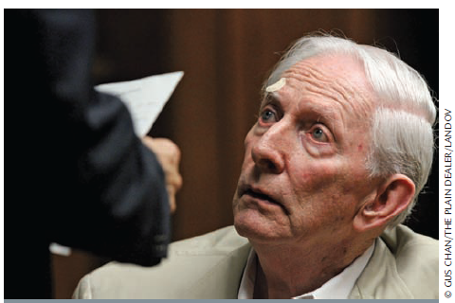
Factors Affecting Ethical Behavior (cont’d)
Three general sets of factors appear to influence the standards of behavior in an organization.
  Individual factors
    Individual knowledge of an issue
    Personal values
    Personal goals
  Social factors
    Cultural norms
    Coworkers
    Significant others
    Use of the Internet
  Opportunity
    Presence of opportunity
    Ethical codes
    Enforcement

Slide 8
Influencing Ethical Behavior
Include symbols or other moral references in e-mails
Close e-mails or include sayings on your desk that implies a moral/ethical standard
Build digital avatars of yourself
Display religious symbols in one’s office or workspace
  “Success without honor is worse than fraud”
  “Integrity matters”
When someone sees another display a moral signal they are unlikely to request unethical behavior of them

Slide 9
Encouraging Ethical Behavior
External to a specific organization
  Governmental legislation and regulations
  Trade association guidelines
Within an organization
  Code of ethics
    A written guide to acceptable and ethical behavior as defined by an organization; it outlines policies, standards, and punishments for violations
  Organizational environment
    Management direction
    Employee training
    Ethics officer
Whistle-blowing
  Informing the press or government officials about unethical practices within one’s organization

Slide 10
Guidelines for Making Ethical Decisions
1. Listen and learn. | Recognize the problem or opportunity; be sure you understand others.
2. Identify the ethical issues. | Examine how others are affected by the situation; understand the viewpoint of those involved in the decision or its consequences.
3. Create and analyze options. | Put aside strong feelings; come up with alternatives; assess which options offer the best results.
4. Identify the best option from your point of view. | Consider and test it against criteria such as respect, understanding, caring, fairness, honesty, and openness.
5. Explain your decision and resolve any differences that arise. | May involve arbitration or additional proposals.

Slide 11
Social Responsibility
Social Responsibility – The recognition that business activities have an impact on society and the consideration of that impact in business decision making
  Social responsibility costs money but is also
  good business.
  How socially responsible a firm acts may affect the decisions of customers to do or continue to do business with the firm.
Does a company’s social responsibility affect your decision to do business with them?

Slide 12
Special Areas of Concern for
Managerial Ethics
Areas of Concern | Sample Issues
Relationship of the firm to the employee | Hiring and firing Wages and working conditions Privacy
Relationship of the employee to the firm | Conflict of interest Secrecy Honesty and expense accounts
Relationship of the firm to customers | Fairness of pricing Honesty in advertising Product safety Right of privacy

Slide 13
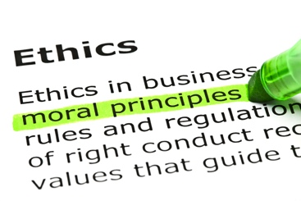
Using the Internet
The International
Business Ethics Institute
is a private nonprofit
educational organization
that promotes global
business ethics and
corporate responsibility.
http://www.business-ethics.org
© IVELIN RADKOV/SHUTTERSTOCK

Slide 14
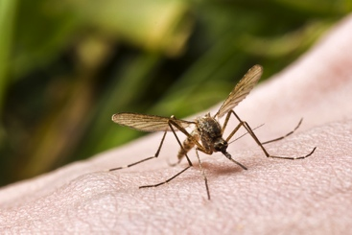
CLASS EXERCISE
How ethical is it?
  The manufacturer of a
  leading insect spray
  changes the formulation
  of its product to eliminate
  problems experienced by
  people allergic to some of
  the ingredients. The
  manufacturer does not
  inform consumers. The change in the formula will make the product less effective.
© DMITRIJS BINDEMANIS/SHUTTERSTOCK

Slide 15

CLASS EXERCISE
How ethical is it?
  A beer company engages in an advertising campaign that is targeted to undergraduate college students, many of whom are under the legal drinking age.
© WAVEBREAKMEDIA/SHUTTERSTOCK

Slide 16

CLASS EXERCISE
How ethical is it?
  A rental car company strongly advises customers to purchase insurance when renting a car. Although most personal car insurance covers the insured motorist when driving a rental car, most rental car customers are not aware of this.
© YURI ARCURS/SHUTTERSTOCK

Slide 17

CLASS EXERCISE
How ethical is it?
  Consumer Reports publishes the
  results of a study on shampoos that
  provides strong evidence that all
  shampoos are basically the same.
  In fact, the results suggest that a
  mild dish-washing liquid will do the
  same job for a lot less money. After the study is published, a leading shampoo marketer claims that its product will remove oil, add body, condition, and replenish hair better than any competing shampoo and do it all in one step.
© ION PRODAN/SHUTTERSTOCK

Slide 18
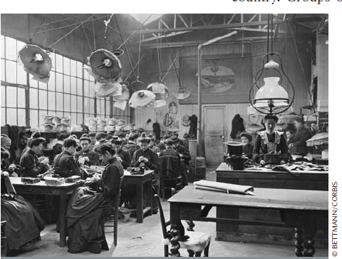
The Evolution of Social
Responsibility in Business
In the first quarter of the 20th century, there were very few government protections for workers or consumers.

Slide 19
The Evolution of Social
Responsibility in Business
Early 1900s:
Caveat Emptor – “Buyer Beware”
  What you see is what you get, and if it’s not what you expected, too bad.
  Most people believed that competition and the marketplace would correct abuses.
  The government became involved only in cases of obvious abuse.

Slide 20
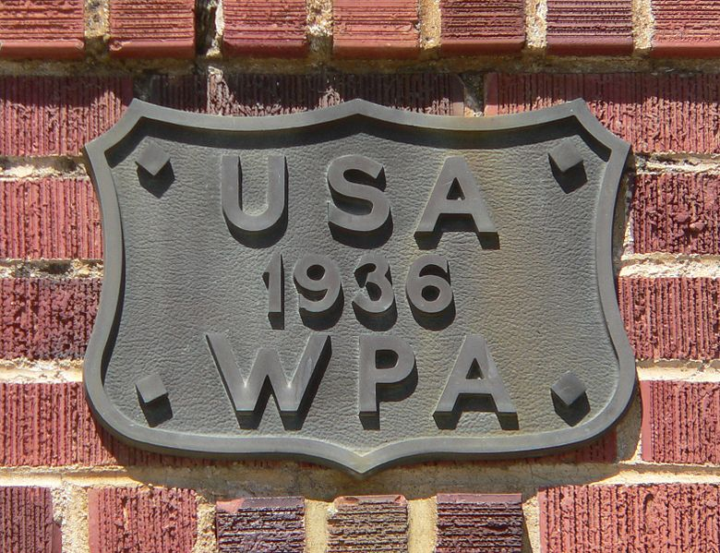
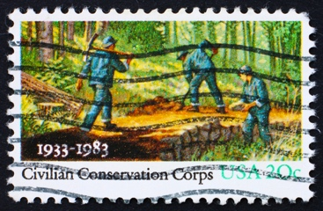
The Great Depression and Beyond
Pressure mounted for the government to help with the economy and social conditions.
Franklin D. Roosevelt instituted economic and social programs like the Works Progress Administration and the Civilian Conservation Corps.
© BORIS15/SHUTTERSTOCK
Civilian Conservation Corps, c.1933
Notes:
Additional Resources
PBS film about the Civilian Conservation Corps
http://www.pbs.org/wgbh/americanexperience/films/ccc/

Slide 21





The Great Depression and Beyond
  As government regulation has increased, so has everyone’s awareness of the social responsibility of business.
Notes:
Additional Resources
Economist article on The Consumer Financial Protection Bureau
http://www.economist.com/blogs/schumpeter/2012/01/consumer-financial-protection-bureau

Slide 22
Two Views of Social Responsibility
Economic model
Originated in the 18th century.
Society will benefit most when business is left alone to produce and market profitable products that society needs.
Company’s primary responsibility is to make a profit for its shareholders.
Social responsibility is the problem of government, environmental groups, and charities.
Notes:
Additional Resources
Overview of Corporate Social Responsibility from Prof. Thomas Beschorner, University of St.Gallen
http://www.youtube.com/watch?v=E0NkGtNU_9w

Slide 23
Two Views of Social Responsibility (cont’d)
Socioeconomic model
Business should be concerned with the impact of its decisions on society.
Firms take pride in their social responsibility obligations.
It is in the best interest of firms to take the initiative in social responsibility matters.
  Society will demand changes if a corporation is not a responsible member of society.
  Provides protection against legal action from special-interest groups.

Slide 24
Two Views of Social Responsibility (cont’d)
Economic Model Emphasisn | Socioeconomic Emphasis
Production | Quality of life
Exploitation of natural resources | Conservation of natural resources
Internal, market-based decisions | Market-based decisions with some community controls
Economic return | Balance of economic return and social return
Firm’s or manager’s interest | Firm’s and community’s interests
Minor role for government | Active government
Is there a middle ground?

Slide 25
The Pros and Cons of Social Responsibility
PRO
CON
As a part of society, business can’t ignore social problems.
Business has the means to tackle social problems.
Addressing social problems can create a more stable environment.
Socially-responsible decision making prevents government intervention.
Businesses are primarily responsible to shareholders.
Corporate time, money and talent should be used to create profit.
Individual businesses can’t be expected to solve problems affecting society in general.
Social issues are the problem of government officials elected for that purpose.

Slide 26
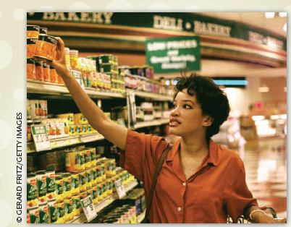
Consumerism
Consumer Bill of Rights
Right to Safety
Right to be Informed
Right to Choose
Right to be Heard
Right to Consumer Education
Right to Service

Slide 27
Major Federal Legislation Protecting Consumers Since 1960
Federal Hazardous Substances Labeling Act (1960) | Warning labels on toxic household chemicals
Kefauver-Harris Drug Amendments (1962) | Drug testing and labeling for both generic and trade names
Cigarette Labeling Act (1965) | Warning labels on packages and ads
Fair Packaging and Labeling Act (1966) | Labels on products sold across states must include net wt, ingredients, and mfg name/address
Motor Vehicle Safety Act (1966) | Standards for safer cars
Truth in Lending Act (1968) | Finance charge disclosure in both dollars and annual percentage rates

Slide 28
Major Federal Legislation Protecting Consumers (cont’d)
Credit Card Liability Act (1970) | Card holder liability limited to $50 per card; unsolicited cards stopped
Fair Credit Reporting Act (1971) | Consumers can get credit reports and correct errors
Consumer Product Safety Commission Act (1972) | Established an abbreviated procedure for registering certain generic drugs
Fair Credit Billing Act (1974) | Consumer can challenge billing errors
Equal Credit Opportunity Act (1974) | Equal credit opportunities for males/females and single/married people
Magnuson-Moss Warranty-Federal Trade Commission Act (1975) | Minimum standards for written consumer warranties for products over $15

Slide 29
Major Federal Legislation Protecting Consumers (cont’d)
Amendments to Equal Credit Opportunity Act (1976, 1994) | Discrimination prohibited when granting credit
Fair Debt Collection Practices Act (1977) | Abusive collection practices by third parties outlawed
Nutrition Labeling and Education Act (1990) | FDA review of food labeling and packaging
Telephone Consumer Protection Act (1991) | Automated dialing and prerecorded-voice calling prohibited
Consumer Credit Reporting Reform Act (1997) | Credit issuers are responsible for accurate credit data
Children’s Online Privacy Protection Act (2000) | Parents control info collected from kids; commercial websites protect child info

Slide 30
Major Federal Legislation Protecting Consumers (cont’d)
Do Not Call Implementation Act (2003) | Directed the FCC and FTC to apply consistent rules on telemarketing
Credit Card Accountability, Responsibility, and Disclosure Act (2009) | Provided the most sweeping changes in credit card protections since the Truth in Lending Act of 1968
Which federal legislation has had the biggest impact on your life?

Slide 31

Employment Practices
A number of
anti-discrimination
laws were passed in
the 1960s and 1970s
but abuses still exist.
Equal Employment Opportunity Commission (EEOC) is the federal agency empowered to investigate complaints of employment discrimination and to sue firms that practice it.
© YURI ARCURS/SHUTTERSTOCK

Slide 32
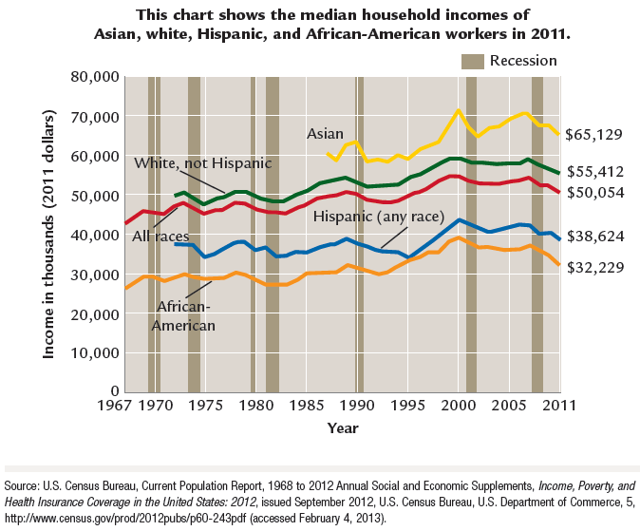
Employment Practices

Slide 33
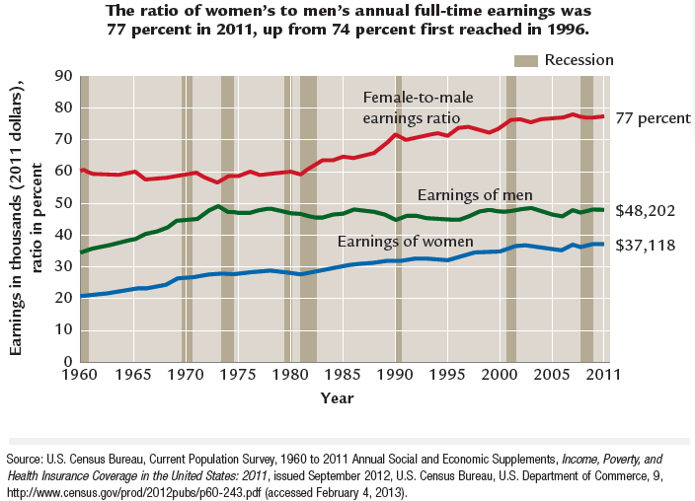
Employment Practices

Slide 34
Employment Practices (cont’d)
Affirmative Action Programs
Designed to increase the number of minority employees at all levels of an organization.
Written plans are required for employers with federal contracts of more than $50,000 per year.
Problems arise from the use of quotas and charges of reverse discrimination.
Do you think there is still a need for Affirmative Action policies?
Notes:
Additional Resources
NY Times Room for Debate on Affirmative Action
http://www.nytimes.com/roomfordebate/2012/02/22/beyond-race-in-affirmative-action

Slide 35
Employment Practices (cont’d)
Training programs for the hard-core unemployed
Hard-core unemployed
  Workers with little education or vocational training and a long history of unemployment
National Alliance of Business (NAB)
  A joint business-government program to train the hard-core unemployed

Slide 36
Major Environmental Laws
National Environmental Policy Act (1970) | Established EPA to enforce federal environmental laws
Clean Air Amendment (1970) | Automotive, aircraft, and factory emission standards
Water Quality Improvement Act (1970) | Strengthened water regulations; provided for large fines
Resource Recovery Act (1970) | Enlarged solid-waste disposal program; EPA enforcement
Water Pollution Control Act Amendment (1972) | Standards for cleaning navigable waters; elimination of harmful waste disposal by 1985
Noise Control Act (1972) | Standards for major sources of noise; EPA advises FAA on standards for planes
Clean Air Act Amendment (1977) | New deadlines for cleaning up polluted areas; review of existing air quality standards

Slide 37
Major Environmental Laws (cont’d)
Resource Conservation and Recovery Act (1984) | Federal regulation of potentially dangerous solid-waste disposal
Clean Air Act Amendment (1987) | National air-quality standard for ozone
Oil Pollution Act (1990) | Expanded oil spill prevention and response activities; established the Oil Spill Liability Trust Fund
Clean Air Act Amendments (1990) | Motor vehicles must be equipped with onboard systems to control about 90% of refueling vapors
Food Quality Protection Act (1996) | Required a new safety standard (reasonable certainty of no harm) for all pesticides used on foods
American Recovery and Reinvestment Act (2009) | $7.22 billion to EPA to protect/ promote “green” jobs, healthier environment

Slide 38
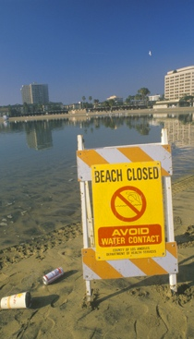
Concern for the Environment
Water pollution
Water quality has improved in recent years, but high levels of toxic pollutants are still found in some waters.
Pollutants threaten the health of both people and wildlife.
Cleanup is complicated and costly because of runoff and toxic contamination.
Acid rain from sulfur emissions of industrial smokestacks is contributing
to the deterioration of coastal waters, lakes, and marine life.
© SPIRITOFAMERICA/SHUTTERSTOCK

Slide 39
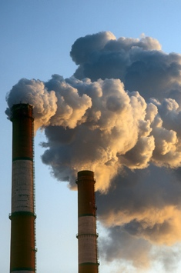
Concern for the Environment (cont’d)
Air pollution
Carbon dioxide emissions in the upper atmosphere are contributing to global warming.
Carbon monoxide and hydrocarbons emitted by motor vehicles and smoke and other pollutants emitted by manufacturing plants can be partially eliminated through pollution-control devices.
Weather and geography can contribute to air pollution.
© M. SHCHERBYNA/SHUTTERSTOCK

Slide 40
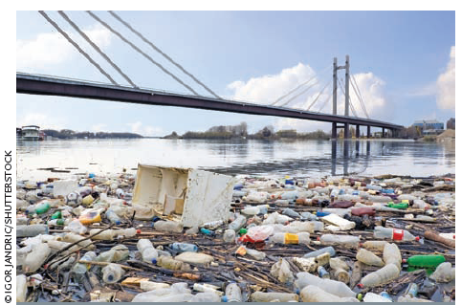
Concern for the Environment (cont’d)
Land pollution
How do we restore damaged or
contaminated land and how
do we protect unpolluted land
from future damage?
Technology produces
chemical and radioactive waste.
Shortage of landfill space for
waste disposal and incinerators produce toxic ash.
Other causes of land pollution include strip-mining, nonselective cutting of forests, development of agriculture land for housing and industry.
The EPA has been criticized for its handling of the $1.6 billion Superfund created in 1980 by Congress.
Notes:
Additional Resources
Congressional Research Service (Library of Congress) report on the Superfund
http://www.nationalaglawcenter.org/assets/crs/RL33426.pdf

Slide 41

Concern for the Environment (cont’d)
Noise pollution
Excessive noise can
do physical harm.
Noise levels can be
reduced by isolating
the source of the
noise or modifying
machinery and equipment.
Noise Control Act of 1972 established noise emission standards for aircraft, railroads, and interstate motor carriers.
© TOMAS SEREDA/SHUTTERSTOCK

Slide 42
Who Should Pay for a Clean Environment?
Governments and businesses spend billions annually
to reduce pollution.
Much of the money required is supposed to come from already depressed industries.
A few firms have discovered it is cheaper to pay a fine than to install equipment for pollution control.
Many business leaders say tax money should be used because business is not the only source of pollution.
Environmentalists say the cost is an expense of doing business.
Consumers will probably pay a large part of the costs—either as taxes or in the form of higher prices.

Slide 43
Environmental Regulations
Do government regulations regarding the environment limit business and economic growth?
Notes:
Additional Resources
Spotted Owl Controversy
http://community.seattletimes.nwsource.com/archive/?date=20000806&slug=4035697
Room for Debate – Keystone Pipeline
http://www.nytimes.com/roomfordebate/2011/10/03/what-are-the-risks-of-the-keystone-xl-pipeline-project

Slide 44
Implementing a Program of
Social Responsibility
Developing a program of social responsibility
  Secure the commitment of top executives.
  Plan the program.
  Appoint top-level executive as director to implement the plan.
  Prepare a social audit--
    A comprehensive report of what the organization has done and is doing with regard to social issues that affect it.
Funding the program
  Pass program costs on to consumers as higher prices.
  Absorb the program costs as a business expense.
  Seek tax reductions or other incentives.

